Slide 1
fMRI MEG similarity based fusion
Nicky Bayat
Fall 2019

Slide 2
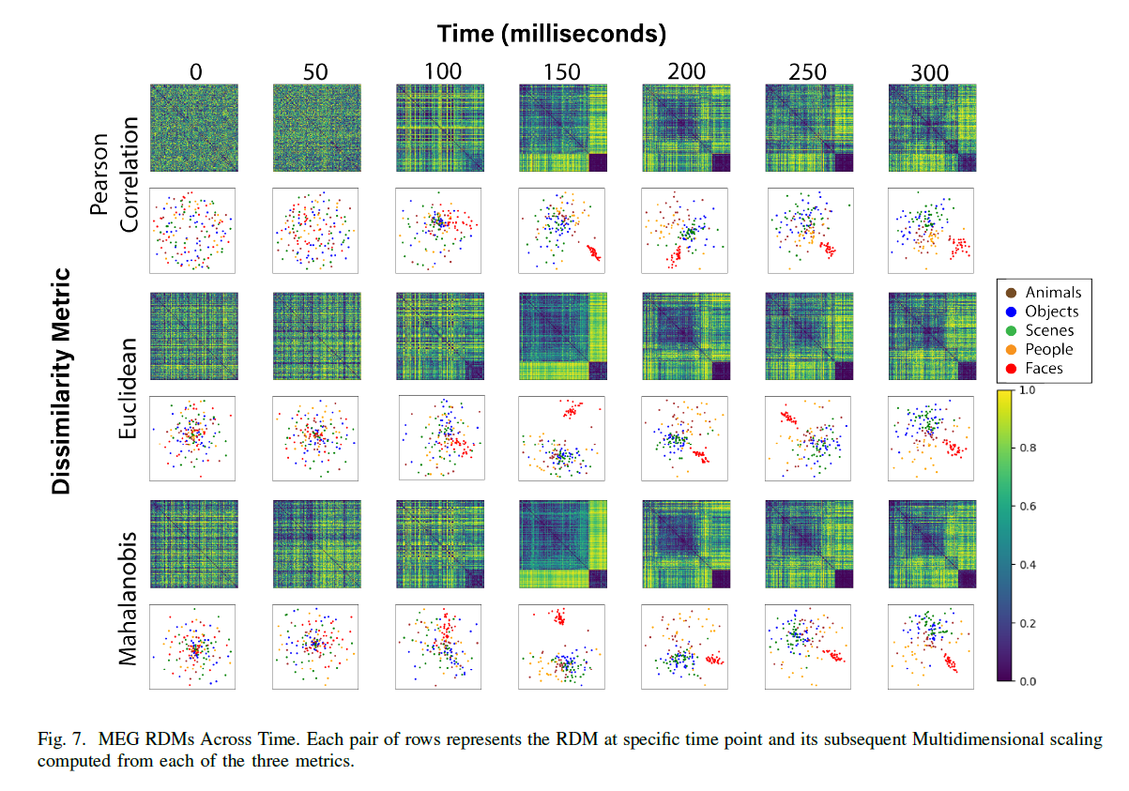
MEG RDMs (1-corr, euclidean and mahalanobis)
Normalization for mahalanobis distance is added to compute covariance.
Normalization for euclidean distance based on std of first 200 time points is used.

Slide 3
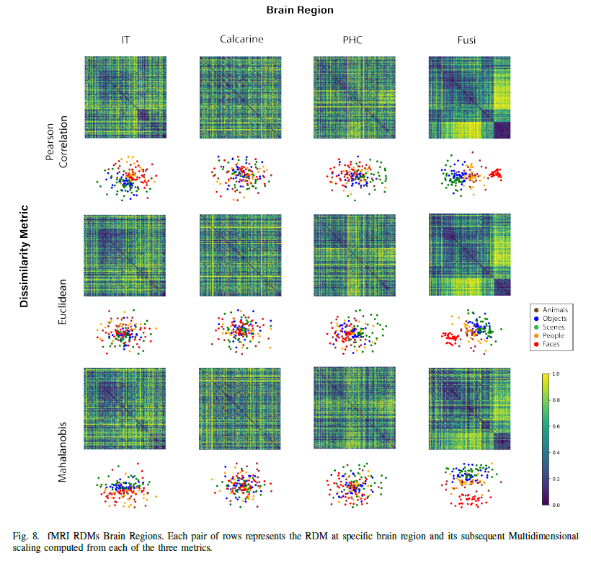
fMRI RDMs (1-corr, euclidean and mahalanobis)

Slide 4
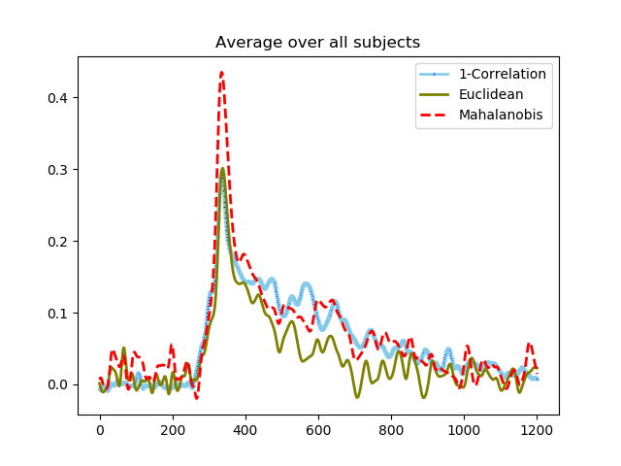
Twin sets created! Correlation between twinsets of MEG:
Don’t have same figure for fMRI
Maybe Haider has it.
This figure was created before normalizing euclidean (magnet sensors)

Slide 5
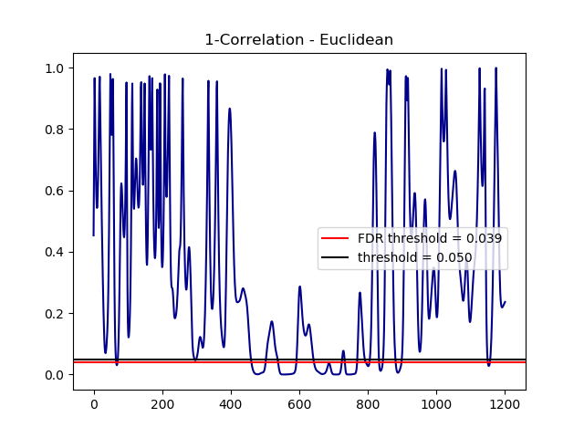
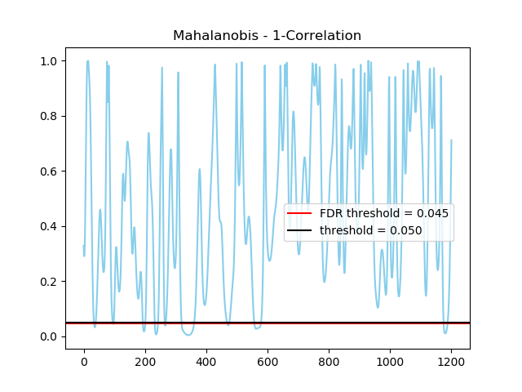
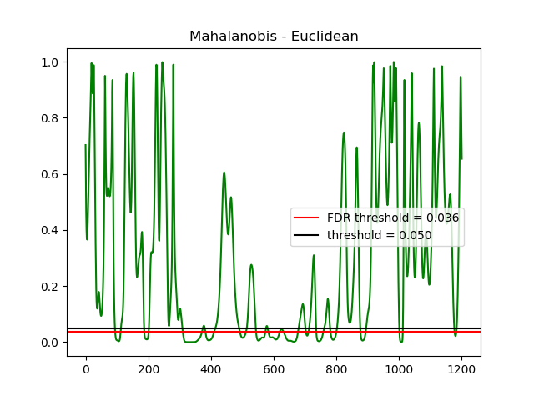
MEG Twinset T-test

Slide 6
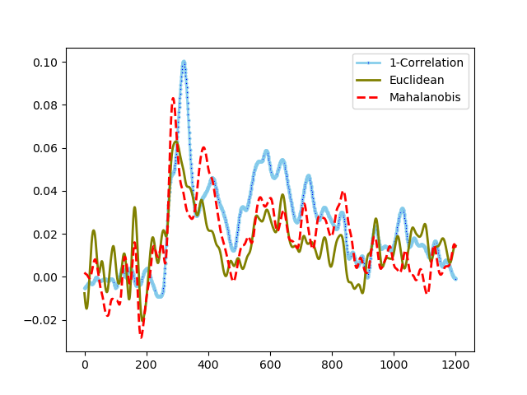
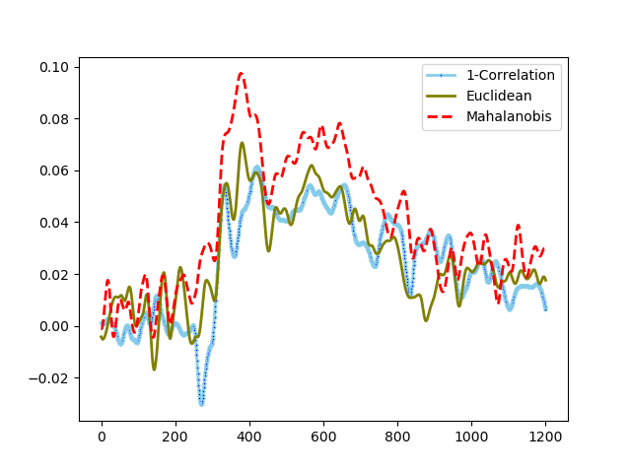
fMRI- MEG Fusion
Calcarine
IT

Slide 7
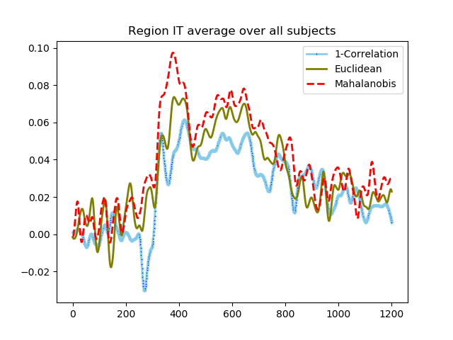
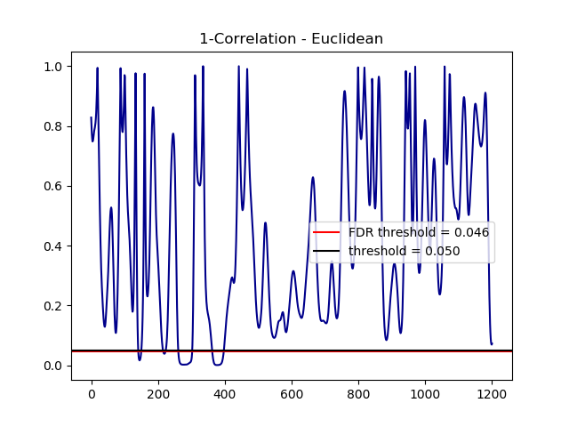
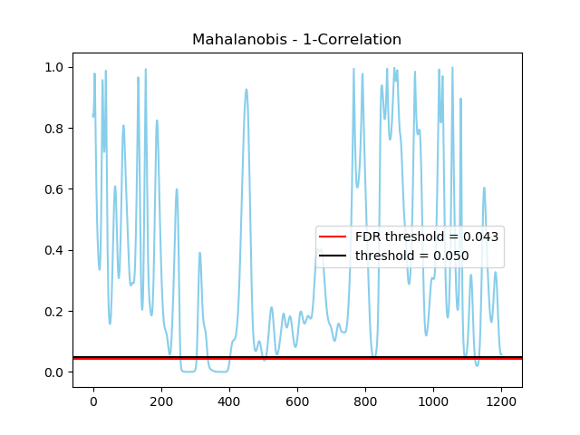
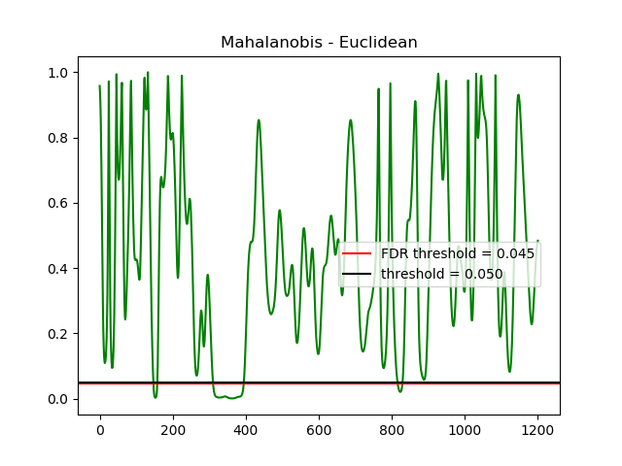
Fusion IT T-test

Slide 8
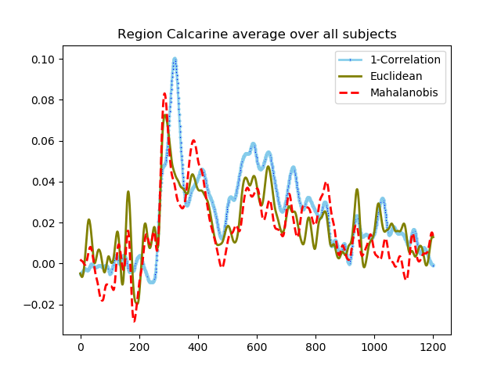
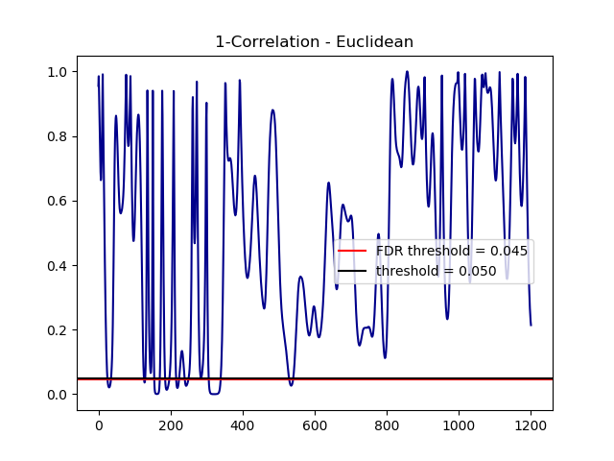
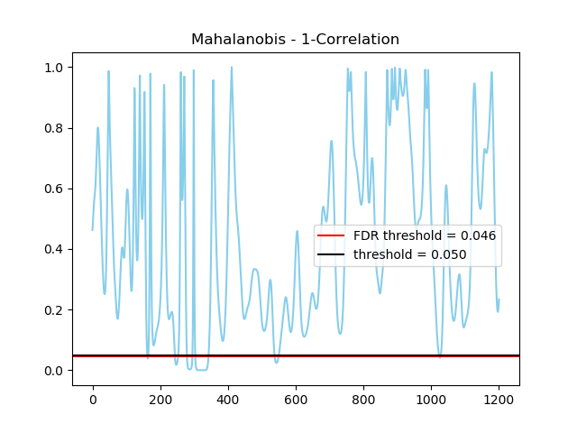
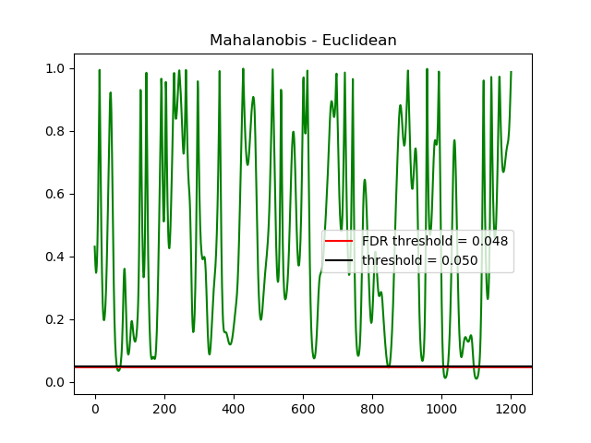
Fusion Calcarine T-test

Slide 9
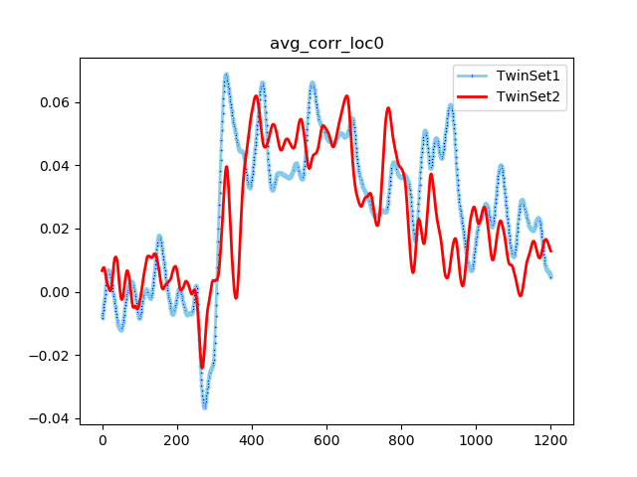
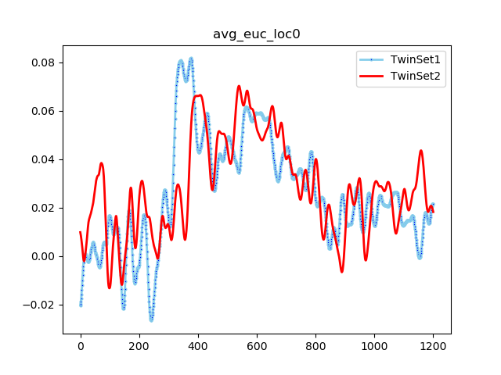
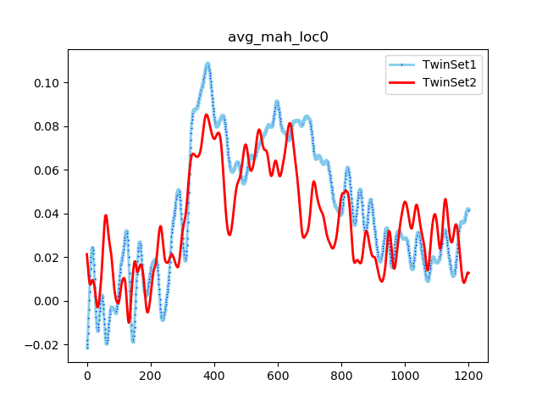
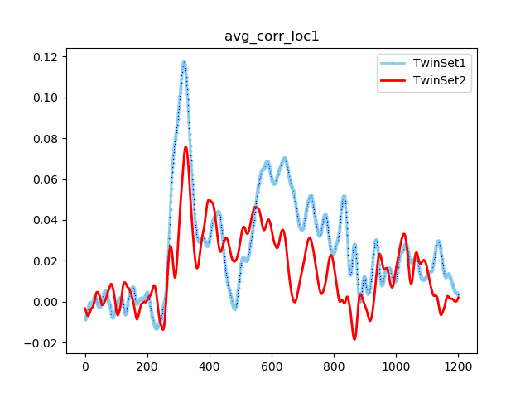
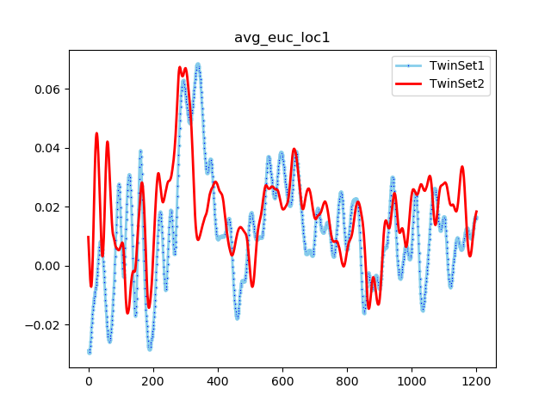
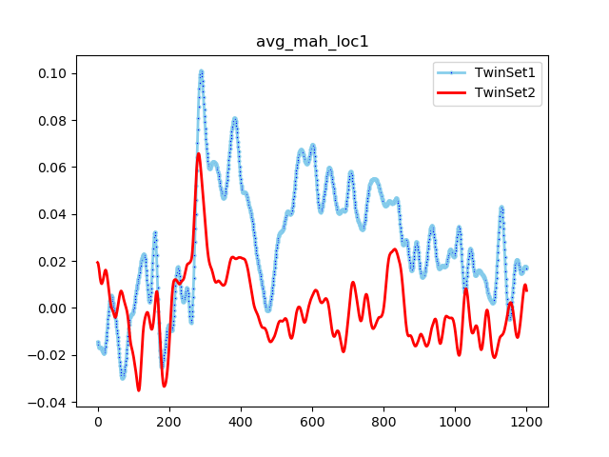
Fusion between twinsets of fMRI and MEG
Waiting for magnet sensor correlation and mahalanobis RDMs to compute this again!

Slide 10
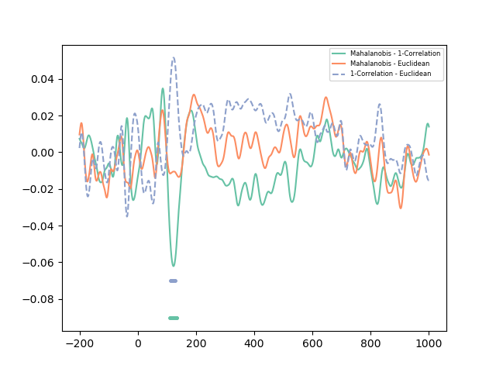
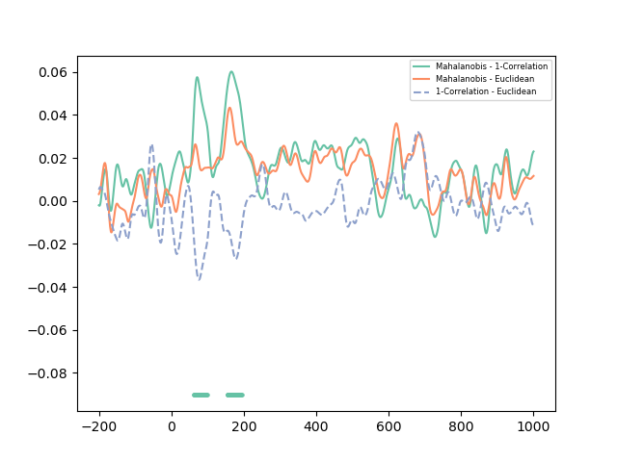

Fusion T-test significant timepoints
IT

Slide 11
Fusion T-test significant timepoints
IT

